Slide 1

IoT and Engineering Education
Hans Scharler
Principle IoT Engineer
MathWorks

Slide 2
Why

Slide 3
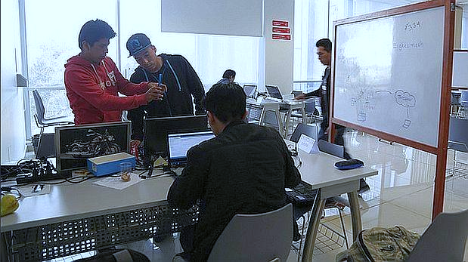

Slide 4
Agenda
The Internet of Things?
IoT tools for engineering education
Keys to success

Slide 5
What is IoT?

Slide 6
(Insert IoT growth chart)

Slide 7
IoT is about collecting data from a lot of things. Analyzing, correlating, and doing something with the data.
- Hans Scharler

Slide 8

Internet of Things
Collect
Constrained things
Geographically dispersed
Analyze
Preprocessing
Stream analysis
Predictive analysis
Historical analysis
Act
Alerts
Control loop

Slide 9
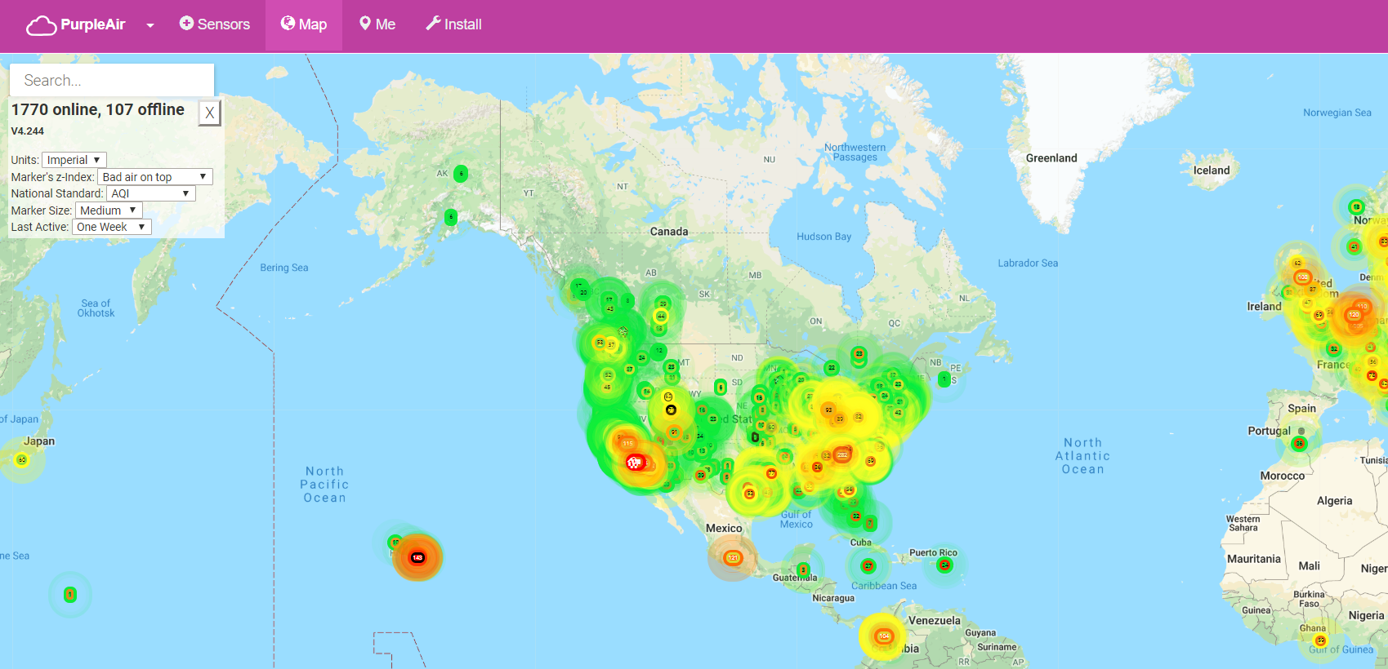

Slide 10
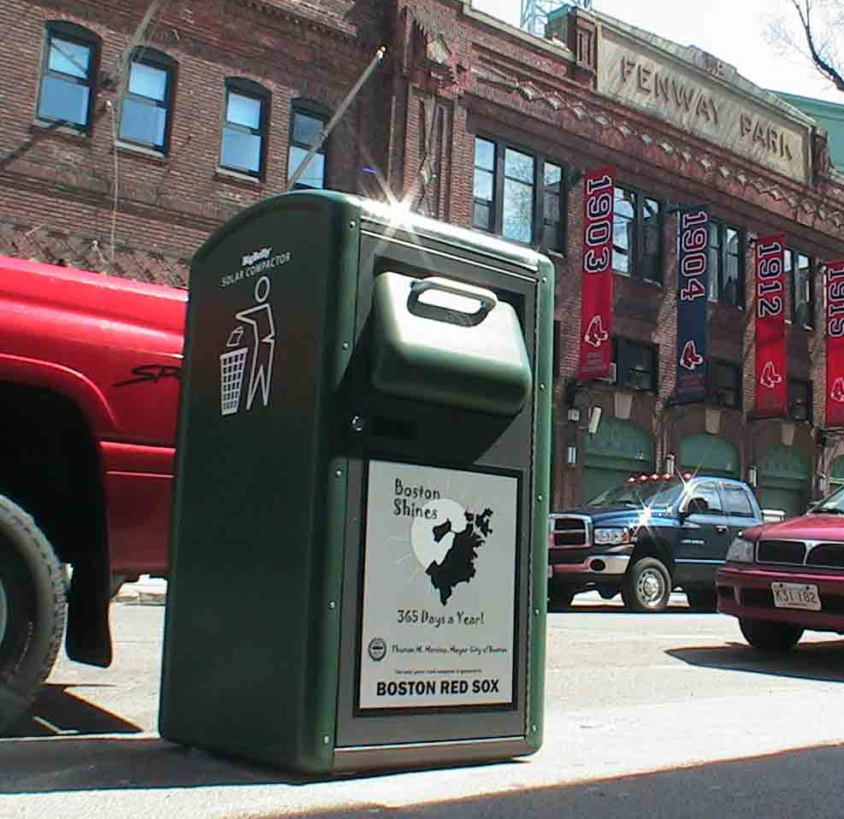
Hmm… when should I pick up the trash? When it’s full.

Slide 11
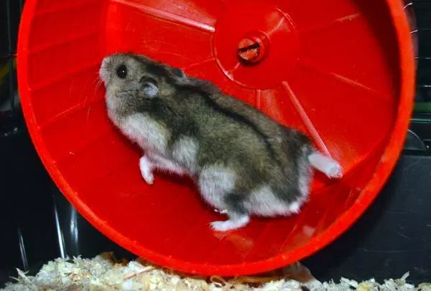
Yes, hamsters do run a marathon every day

Slide 12
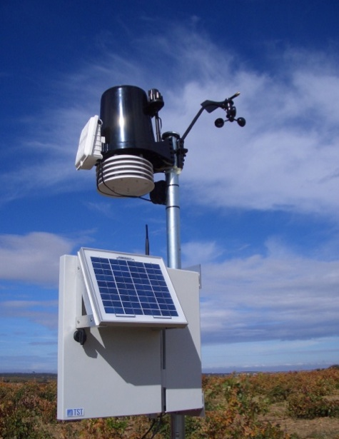
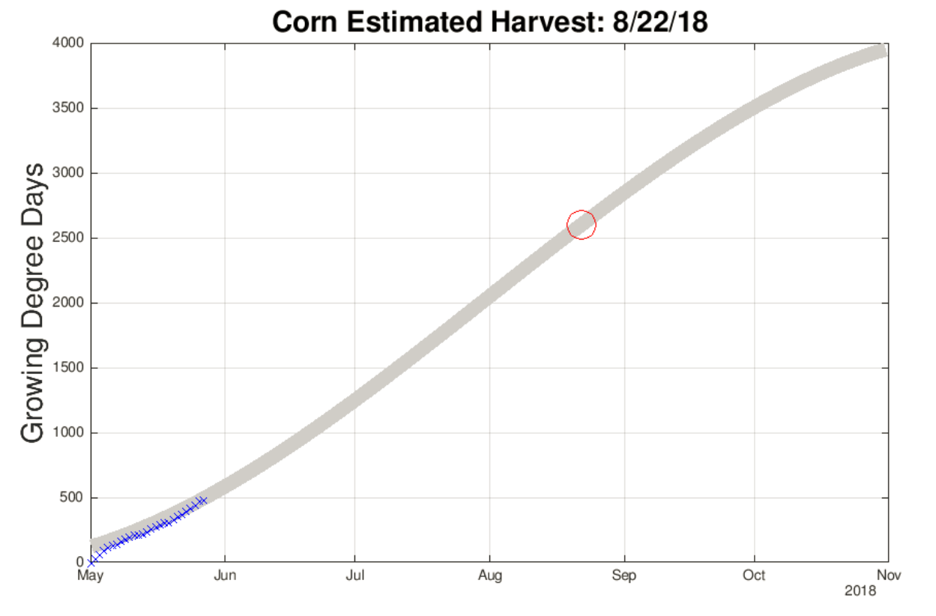

Slide 13
(My) IoT Observations
Projects involve people from different backgrounds and skills
Hardware
Software
Cloud
Data Science
Marketing
Art

Slide 14
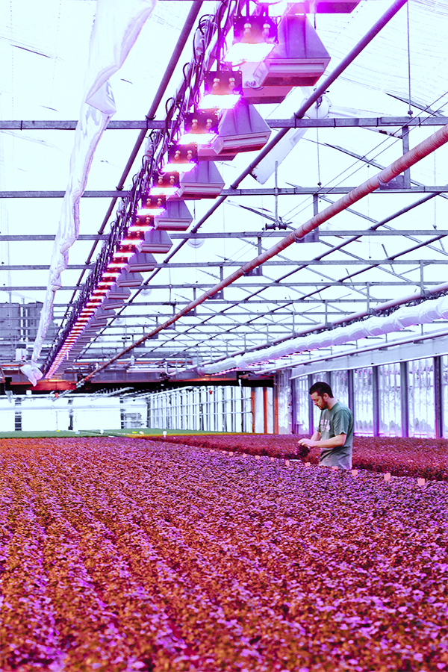
Early IoT Market Traction
Predictive maintenance in manufacturing
Smart agriculture
Environmental monitoring
Generally:
Improve existing system
Situational awareness
Reduce truck rolls

Slide 15
IoT Tools

Slide 16
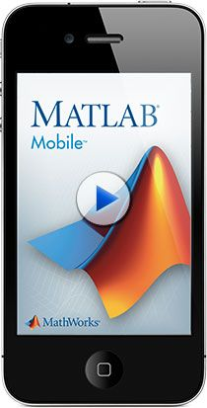
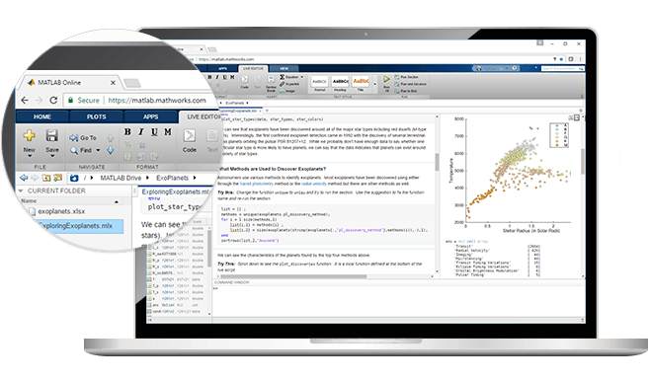
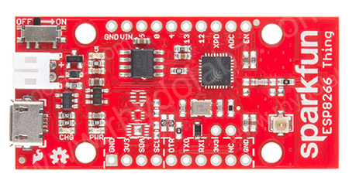
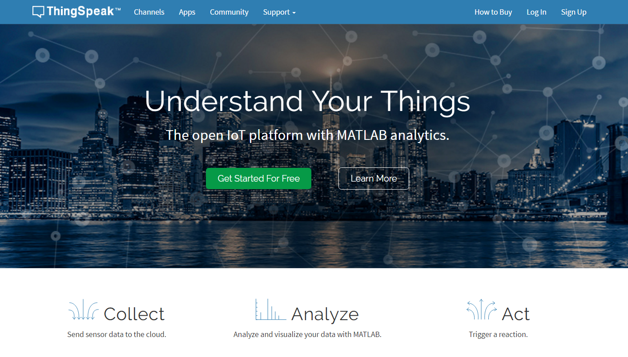

Slide 17
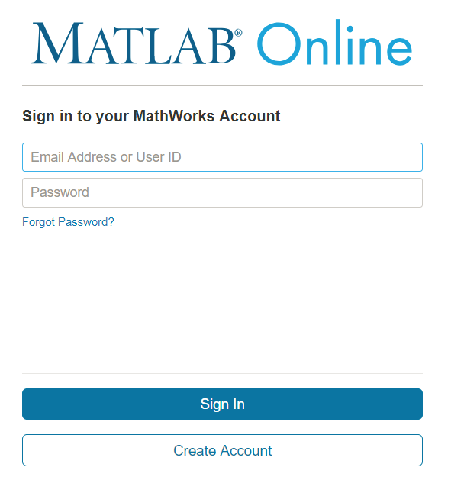
MathWorks Account
Same account used on MATLAB Central
Use MathWorks Account to access:
ThingSpeak
MATLAB Online
MATLAB Mobile
MATLAB Drive

Slide 19
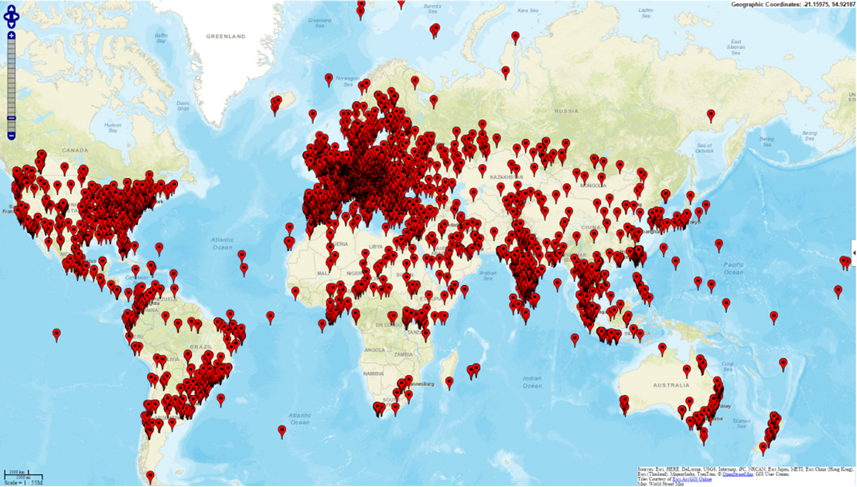

Slide 20
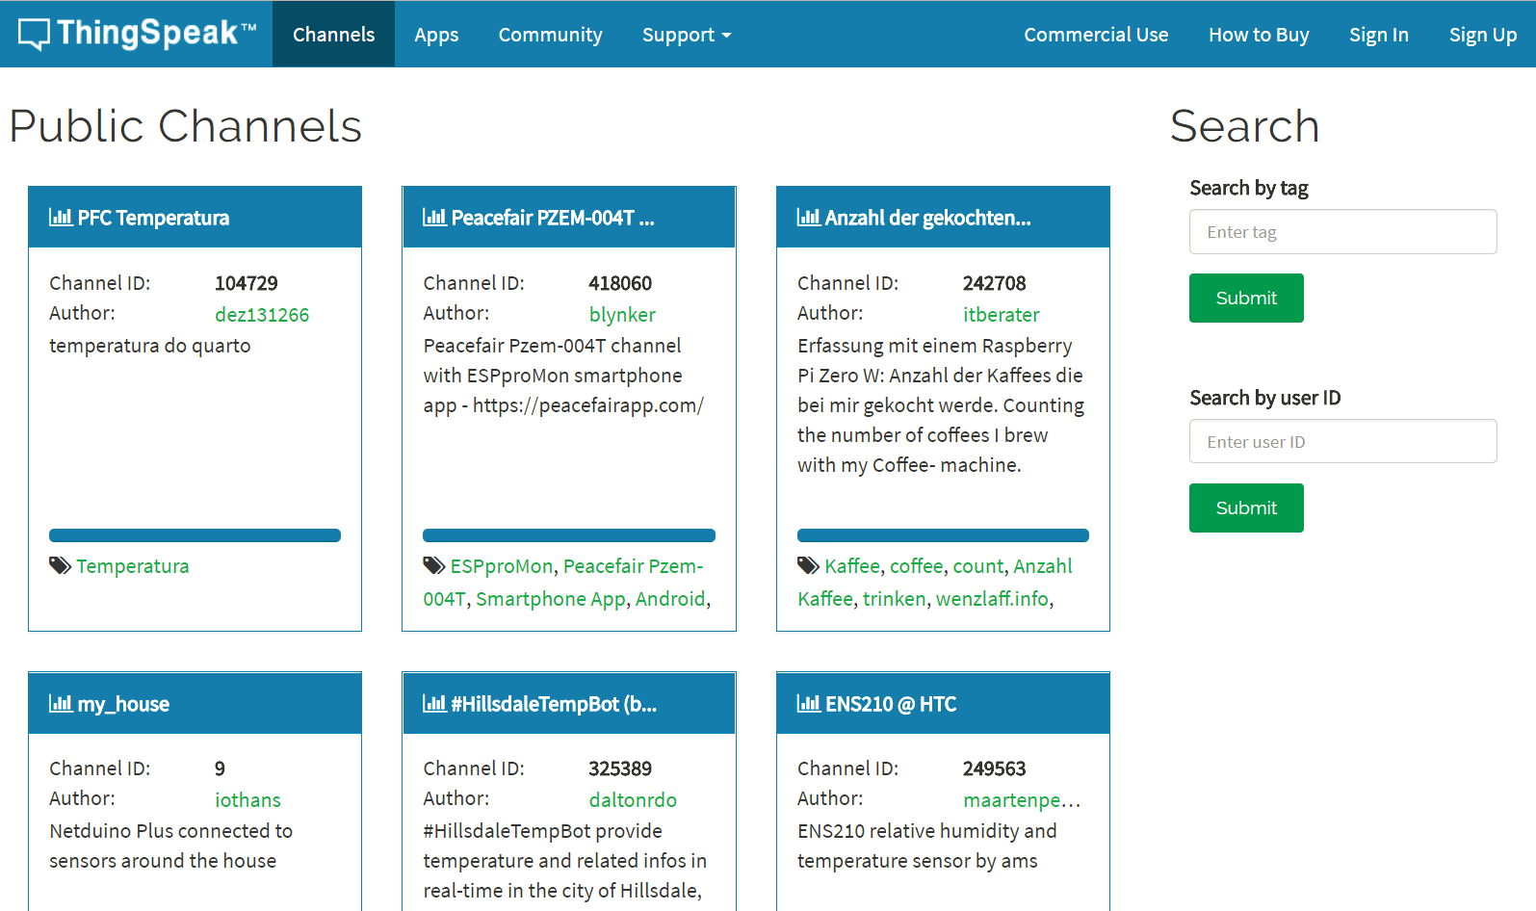

Slide 21
ThingSpeak
Send sensor data via HTTP(S) and MQTT APIs
Run MATLAB code on inbound data
Schedule MATLAB code
Visualize data with MATLAB code
Integrate with 3rd-party systems
Paid Student and Academic account types available

Slide 22
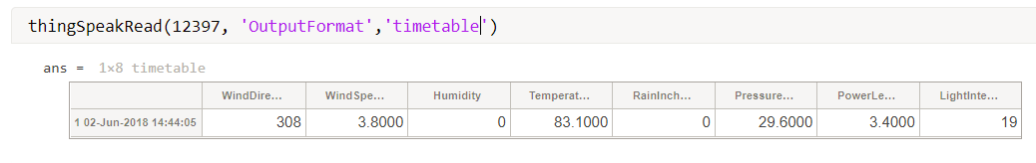
ThingSpeak + MATLAB
From MATLAB – Historical Analysis – ThingSpeak Support Toolbox
From ThingSpeak – Stream Analysis – Latest Release of MATLAB

Slide 24
MATLAB Mobile
Access to mobile device’s sensors
GPS location
Accelerometer
Magnetic field
Orientation
Angular velocity

Slide 25
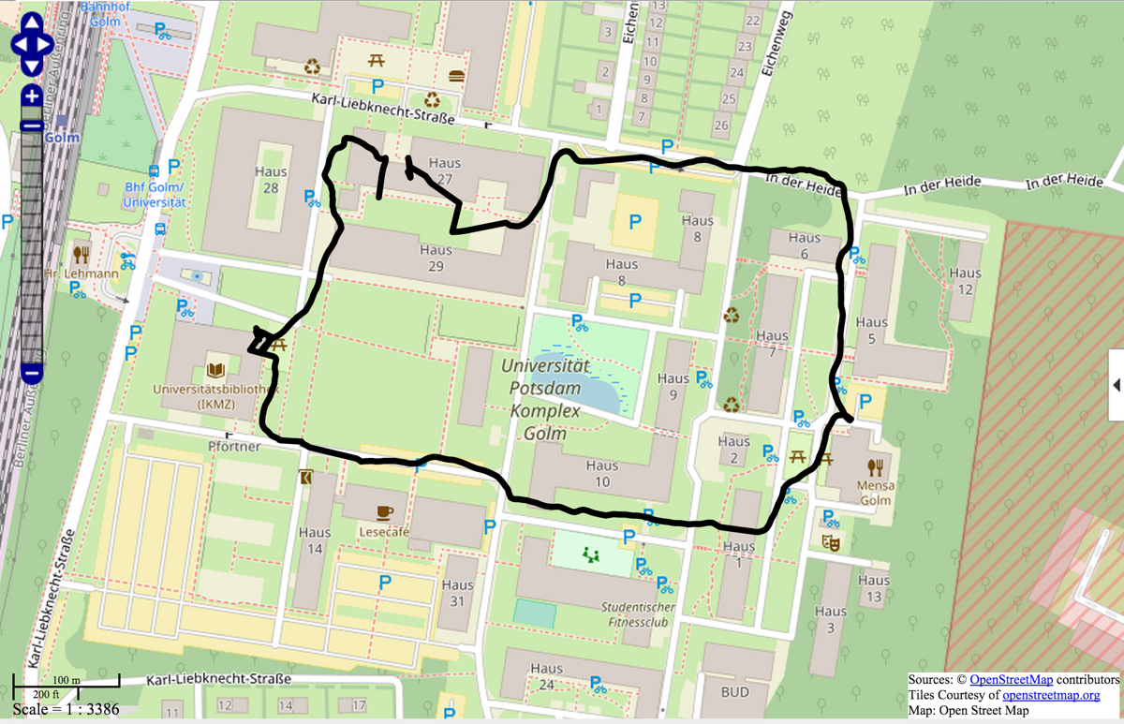
MATLAB Mobile

Slide 26
Low-cost Hardware
SparkFun ESP8266 Thing
Onboard Wi-Fi
Programmable Microcontroller Unit (MCU)
Uses Arduino IDE to program
Low-cost
Perfect for IoT projects and teaching concepts

Slide 28
Keys to Success

Slide 29


Hackathons
Constrained
Multidisciplinary team
They wanted to know how
Detecting Illegal Miners in the Amazon
Iberotec - Lima, Peru

Slide 30
What to do/encourage?
Build Projects!
“Design by constraints”
Invite people from other disciplines
Use Open Data?
Learn Web API tools
Use POSTMAN (add-on for Chrome)
Send data to ThingSpeak’s Web API
Use Mobile Devices
Embrace their ubiquity
Collect data with the sensors and connectivity options
Use Low-cost Hardware
$15.95 Wi-Fi + MCU
10,000’s of open source Arduino examples!

Slide 31
Thank You!
ThingSpeak.com
MathWorks.com/help/thingspeak
MathWorks.com/hardware-support.html
Hans Scharler
Hans.Scharler@mathworks.com
https://thingspeak.com/channels/public
http://bit.ly/thingspeak-workshop

